Slide 1
Matrix Addition Using OpenMP
By Nodebechukwu Okoye

Slide 2
What is OpenMp?
an application programming interface (API) that supports multi-platform shared-memory multiprocessing programming in C, C++, and Fortran
OpenMP is used for parallelism within a (multi-core) node.
Unified code for both serial and parallel applications: OpenMP constructs are treated as comments when sequential compilers are used.
can work on one part of the program at one time, no dramatic change to code is needed

Slide 3
Difference between openmp and pthreads
Category | OpenMP | Pthread
Meaning | Open Multi Processing | POSIX threads
Thread behaviour definition | Defined by Compiler by compiler and system | Defined by the programmer
Level of Flexibilty | Less Level | High Level
Application Paralleliztion | Application is parallelized incrementally by programmer | Application is parallelized all at once
Library | Library requires compiler support | Library is independent of the compiler
Programming Model | Shared Memory | Threads

Slide 4
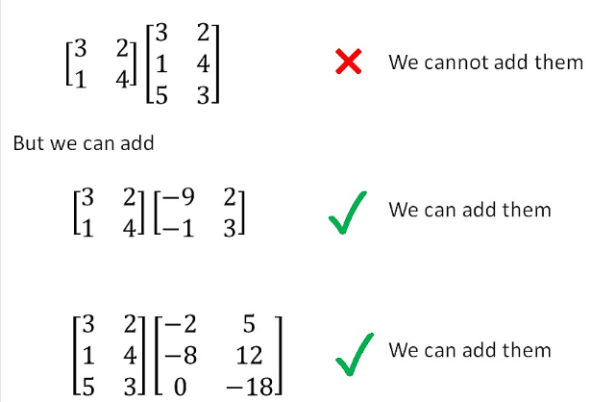
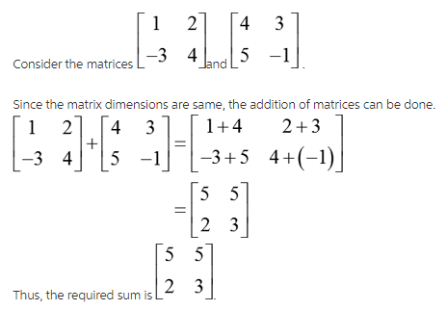
How to perform matrix addition

Slide 5
ALGorithm
Serial IMPLEMENTATion
PARALLEL IMPLEMENTATION
Fill up an array
Begin timer
Perform Matrix Addition
Stop timer
Calculate execution time
Fill up an array
Begin timer
Perform Matrix Addition in a block partition.
Stop timer
Calculate execution time

Slide 6
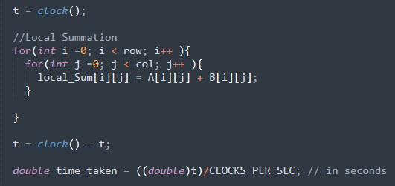
Serial code

Slide 7
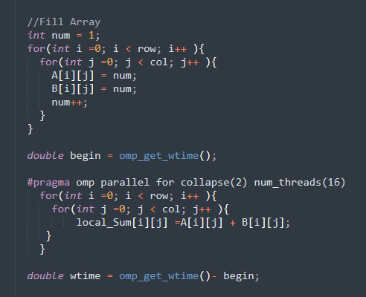
Parallel code

Slide 8
RESULTS
Execution Time
Number of Thread | Order of Matrix
 | 1024*1024 | 2048*2048 | 1024*10000 | 10000*10000
serial Code | 0.02 | 0.03 | 0.07 | 0.049
4 | 0.0039 | 0.015 | 0.02 | 0.205
8 | 0.0017 | 0.003 | 0.0098 | 0.09
16 | 0.0012 | 0.0044 | 0.007 | 0.077
Speedup
Number of Thread | Order of Matrix
 | 1024*1024 | 2048*2048 | 1024*10000 | 10000*10000
4 | 5.128205128 | 2 | 3.5 | 0.2390243902
8 | 11.76470588 | 10 | 7.142857143 | 0.5444444444
16 | 16.66666667 | 6.818181818 | 10 | 0.6363636364

